Slide 1
Student Investment account
Yoncalla school district expenditures
Annual Report 2021-22

Slide 2
introduction
The Oregon Legislature passed the Student Success Act in 2019 including the Student Investment Account for K-12 students.
The Student Investment Account is a grant available to all Oregon school districts and eligible charter schools established for two purposes: (1) meeting students’ mental or behavioral health needs and (2) improving academic outcomes and reducing academic disparities for students of color, students who are tribal citizens, students with disabilities, emerging bilingual students, and students navigating homelessness, and foster care.
The Student Investment Account grants give districts wide latitude in determining through the engagement process how best to use the allocated funds to improve outcomes for students as long as the use falls within one of four allowable categories: (1) increased instructional time, (2) improving student health and safety, (3) reducing class size, and (4) well-rounded education.
The attached spending report shows how Yoncalla School District utilized the Student Investment Account grant during the 2021-2022 school year.

Slide 3
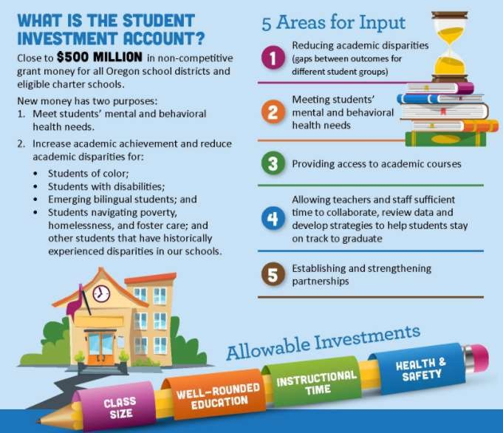

Slide 4
Parent Survey Information 2019-20

Slide 5
YONCALLA SCHOOL DISTRICT STUDENT INVESTMENT ACCOUNT FISCAL YEAR 2021-2022 SPENDING REPORT
Proposed Activity | Amount Spent
Dean of Students | $78,938.66
School Nurse | $19,312.50
K-6 Transition Specialist | $16,197.42
Dual Credit Coordinator | $15,924.43
Grant administration Costs | $1,584.97
Emergency License Fee | $369.36
Attendance Report Cards | $132.00
Total Costs | $132,459.34

Slide 6
Questions?

